Slide 1

Implementation of Trimmed Isogeometric Analysis Membrane Structures
Supervisor:
Andreas Apostolatos
Team:
Bassel Saridar
Cleo Reihl
Dagmawi Bekel
Khaled Boulbrachene
Mahmoud Ammar
Mahmoud Zidan
Muhammad Salman Yousaf
Srikkanth Varadharajan

Slide 2
Outline
Introduction
Parsing
Preprocessing
Triangulation
Cables
Fixing Control Points Without Contribution
Gauss Points for Visualization
Results

Slide 3
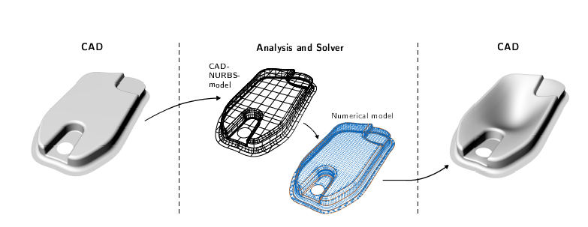
Iso-Geometric B-rep Analysis (IBRA)
New Structural Analysis Technique
Uses Iso-Geometric Analysis Techniques
Allows direct analysis of CAD models
Realization of CAD-integrated Shell Simulation
based on Isogeometric B-Rep Analysis
T. Teschemacher1*, A. M. Bauer1, T. Oberbichler1, M. Breitenberger1, R. Rossi2, R. Wüchner1 and
K.-U. Bletzinger1

Slide 4
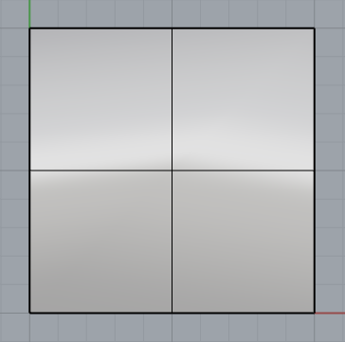
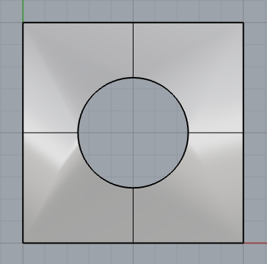
Trimming Surfaces
Surfaces Cut-off from original surface
Curves separating visible to non visible surfaces
Include their own Parametric Space

Slide 5
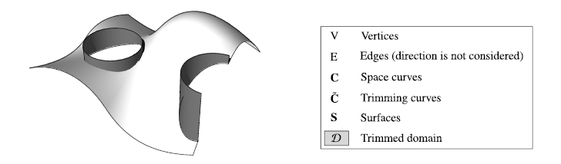
Boundary Representation (B-rep)
Used in CAD
Describes object by its Skin
Components:
Faces = Surfaces
Edges = Curves
Vertices = Points

Slide 6
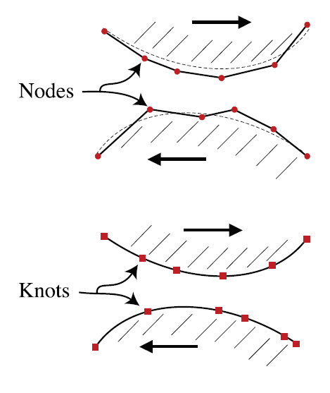
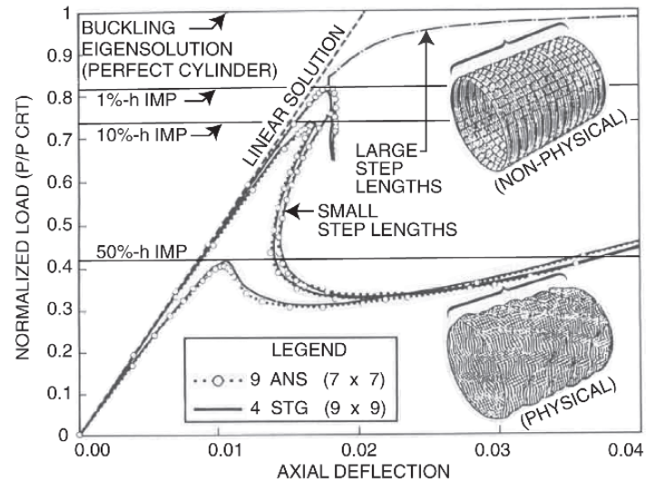
Motivation for IGA
FEM
IGA
Smooth geometry requirement
1. Contact
2. Shell buckling
3. Boundary layer phenomenon

Slide 7
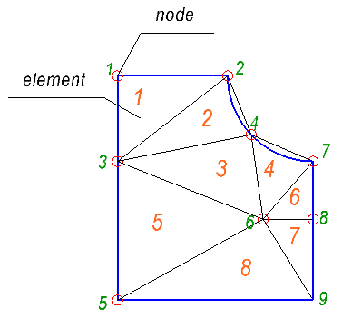
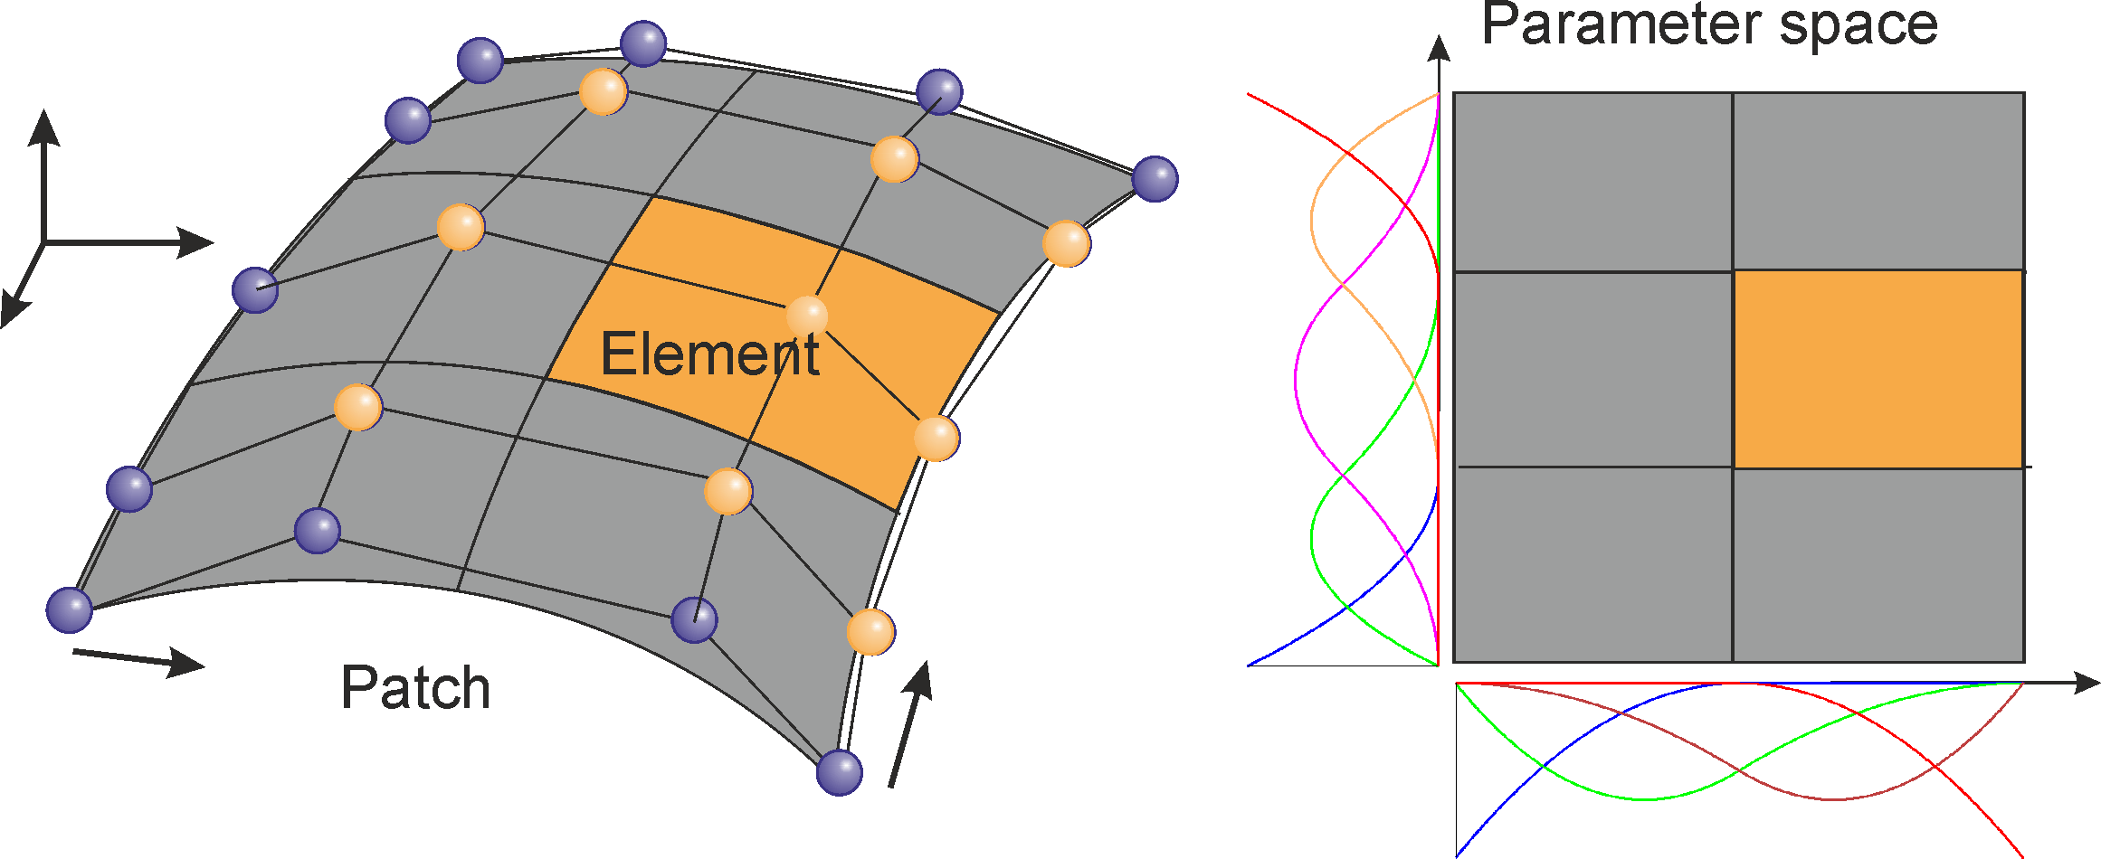
Comparison between FEM and IGA
1. Element definition
FEM
IGA

Slide 8
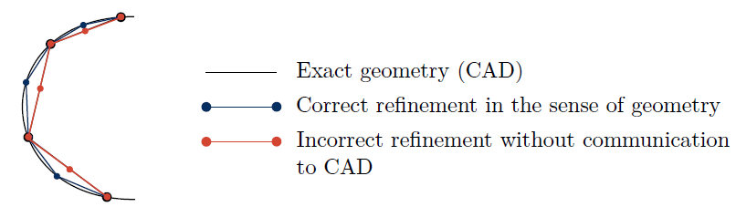
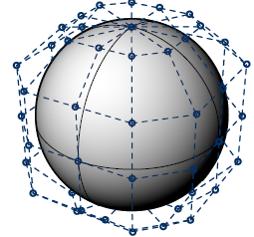
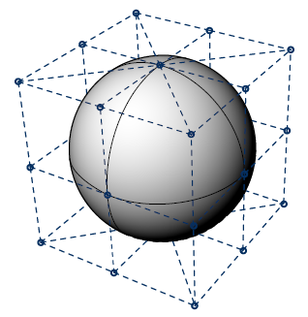
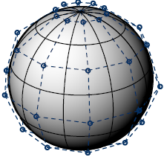
Comparison between FEM and IGA
2. Refinement
a. FEM
b. IGA
Order elevation
Knot insertion
Exact NURBS representation

Slide 9
Outline
Introduction
Parsing
Preprocessing
Triangulation
Cables
Fixing Control Points Without Contribution
Gauss Points for Visualization
Results

Slide 10
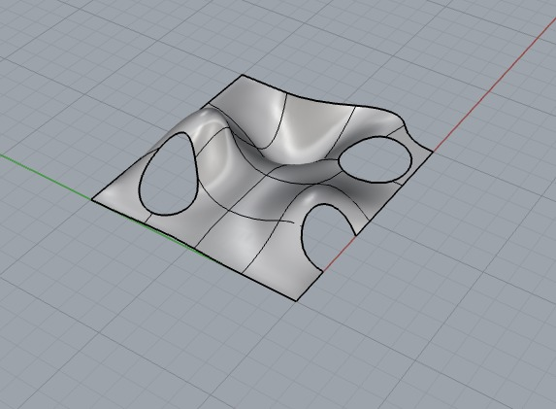
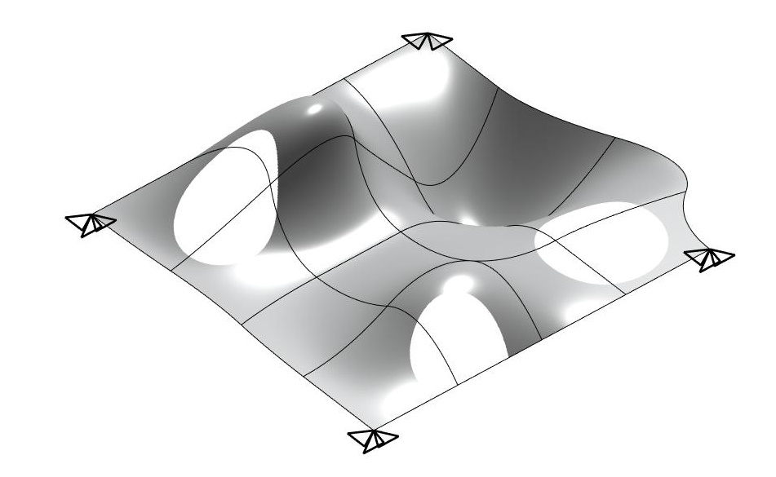
Parsing
Create the CAD geometry in Rhino.
Using TeDa Plugin, Create a JSON file.
Read JSON file in Matlab.
Rhino
Matlab
Munich, 24. July 2018 | Advanced FEM Presentation | SS2018

Slide 11
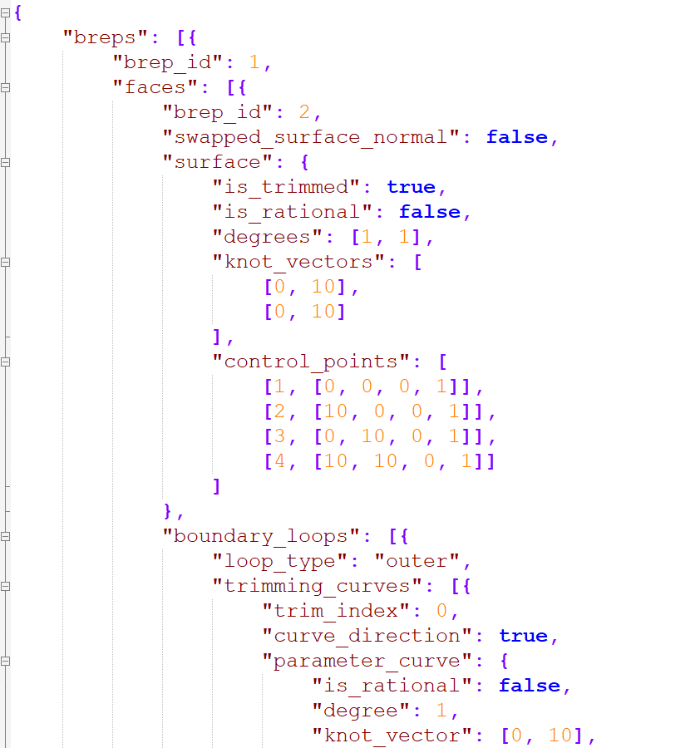
JSON File Structure
Example:
Polynomial Degree
=
p_surface = val.breps.faces.surface.degrees(1)
Knot Vector
=
Xi_surface = val.breps.faces.surface.knot_vectors{1,:}';
Munich, 24. July 2018 | Advanced FEM Presentation | SS2018

Slide 12
JSON Parser
JSON Parser function was implemented in order to return the parsed geometry information from the JSON File created with Rhino 5
Input
Folder Name Containing the JSON File
Output
1 | Polynomial Degree of the untrimmed Patch in Xi-direction
2 | Polynomial Degree of the untrimmed Patch in Eta-direction
3 | Knot vector of the untrimmed Patch in Xi-direction
4 | Knot vector of the untrimmed Patch in Eta-direction
5 | Control Points of the untrimmed Patch
6 | Trimming curves structure
Munich, 24. July 2018 | Advanced FEM Presentation | SS2018

Slide 13
Trimming curves structure
Structure containing all trimming curve information
Trimming curves structure
1 | Number of curves in the outer boundary loop
2 | Polynomial Degree of the outer trimming curve
3 | Knot vector of the outer trimming curve
4 | Control points of the outer trimming curve defined in counter-clockwise direction
5 | Number of inner boundary loops
6 | Knot vector of the inner trimming curve
7 | Control points of the inner trimming curve defined in clockwise direction)
Munich, 24. July 2018 | Advanced FEM Presentation | SS2018

Slide 14
Outline
Introduction
Parsing
Preprocessing
Triangulation
Cables
Fixing Control Points Without Contribution
Gauss Points for Visualization
Results

Slide 15
Preprocessing
After Parsing
Surface
Trimming Curves
Control Points
Knot Vectors
Polynomial Degrees
Knot Vectors
Polynomial Degrees
Control Points
Parametric Surface
Mapping
Notes:
After parsing we have the control points, knot vectors, and polynomial degrees for both the surface and the trimming curves
Regarding the surface, the knot vectors define the Parametric surface
For the trimming curves we use the control points, knot vectors, and polynomial degrees of the trimming curves
To map the trimming curves from …

Slide 16
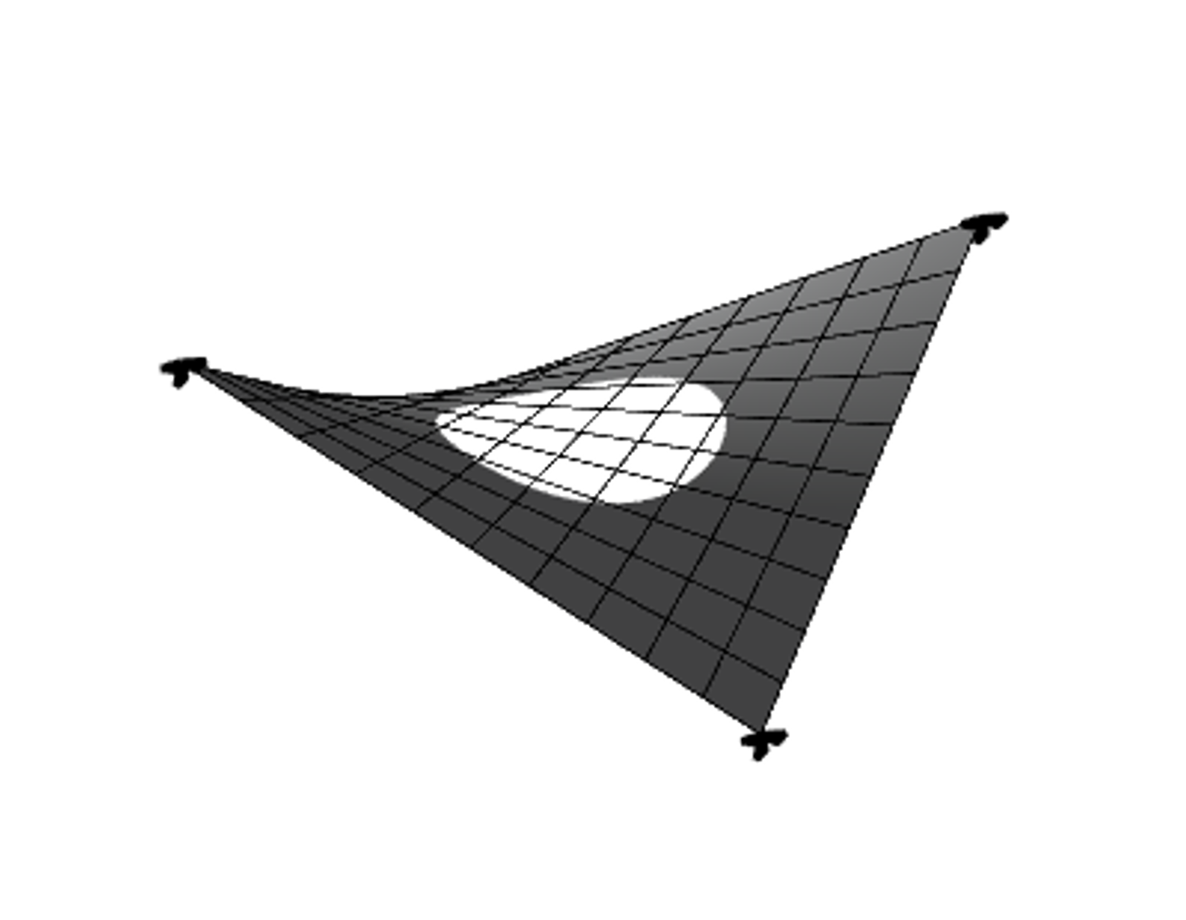
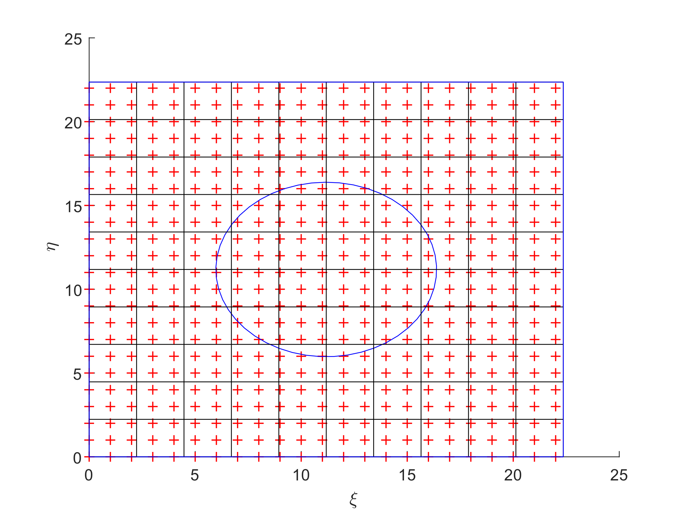
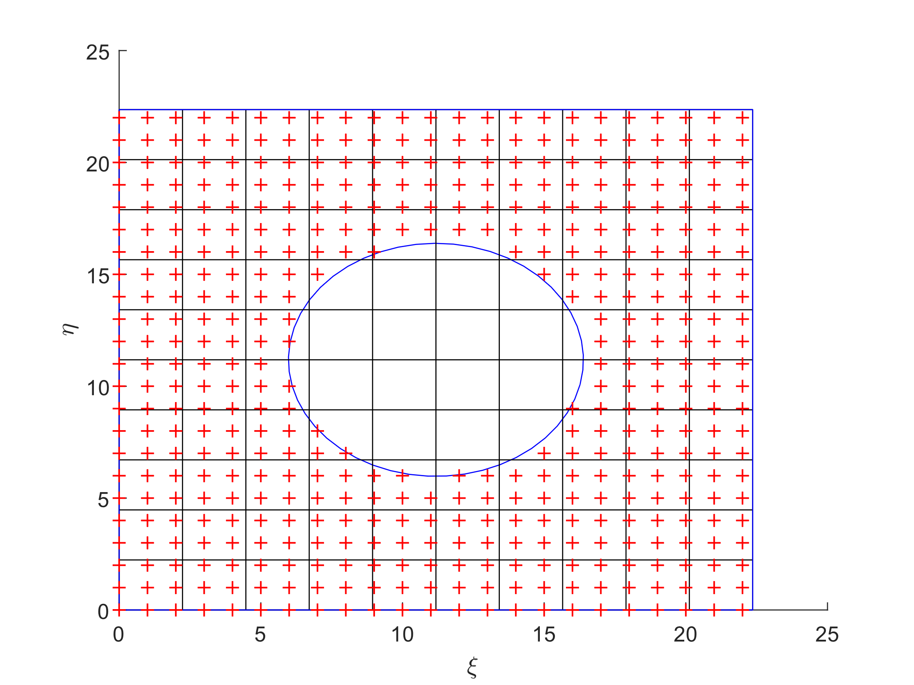
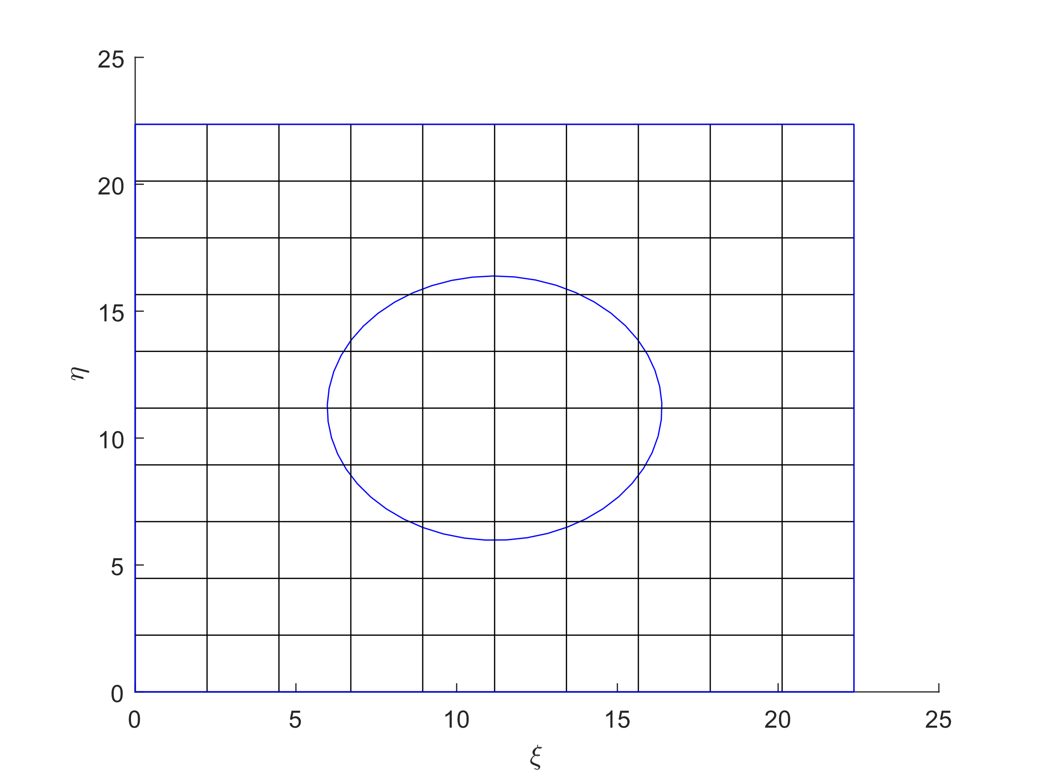
Preprocessing (cont‘d)
Parametric Surface
Evaluation Points
Eliminating Outside Evaluation Points
Mapping to Physical Surface
Notes:
Out example: Four point sail
Parametric surface with trimming curves and here there are the knot span
Distribute the evaluation points along the parametric surface
We polygonized the trimming curve in order to use the inpolygon MATLAB function to convert the coordinates of the inside the polygon to NaN
Mapping from the Parametric surface to the Physical surface through mapping each evaluation point using the Basis functions “R”

Slide 17
Outline
Introduction
Parsing
Preprocessing
Triangulation
Cables
Fixing Control Points Without Contribution
Gauss Points for Visualization
Results

Slide 18
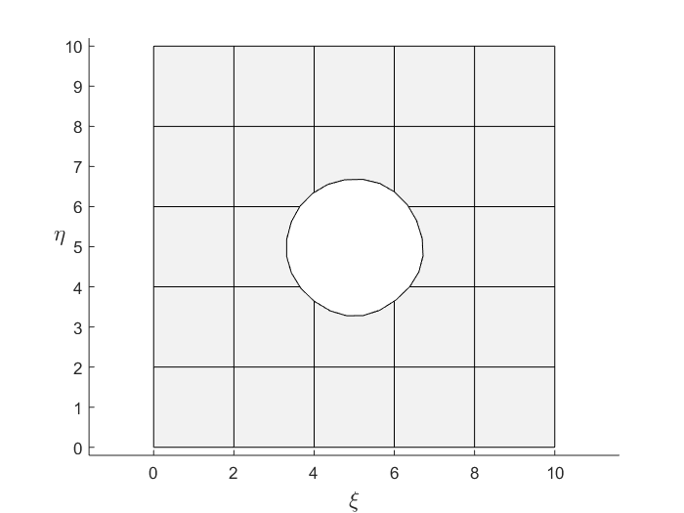
Triangulation
In order to do the analysis of the trimmed isogeometric patch Gauss points have to be distributed
Steps:
Find the intersected Elements
Triangulate intersected elements
Distribute Gauss Points in not intersected elements
Distribute Gauss Points in the intersected elements
Parameter domain
Munich, 24. July 2018 | Advanced FEM Presentation | SS2018

Slide 19
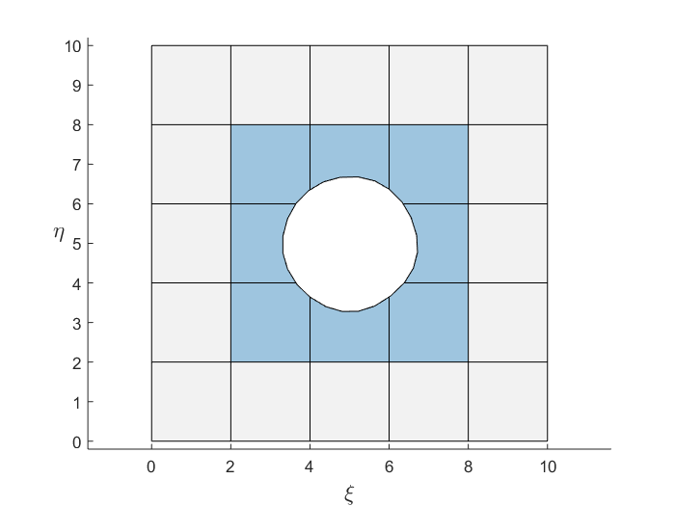
Triangulation (cont‘d)
1. Find the elements of the patch that are being intersected by the boundary loop
The boundary loop is not a smooth curve, but rather a polygon of the discrete points lying on the trimming curve
Parameter domain
Munich, 24. July 2018 | Advanced FEM Presentation | SS2018

Slide 20
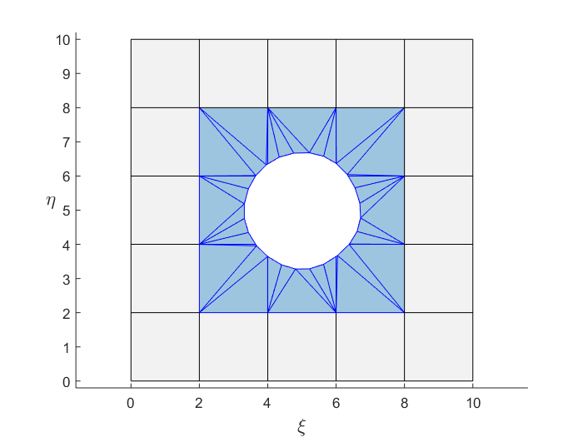
Triangulation (cont‘d)
2. Triangulate the elements that are being intersected by the inner trimming curve using the constrained Delaunay triangulations
Number of triangles depends on the number of discrete point on the trimming curve
Parameter domain
Munich, 24. July 2018 | Advanced FEM Presentation | SS2018

Slide 21

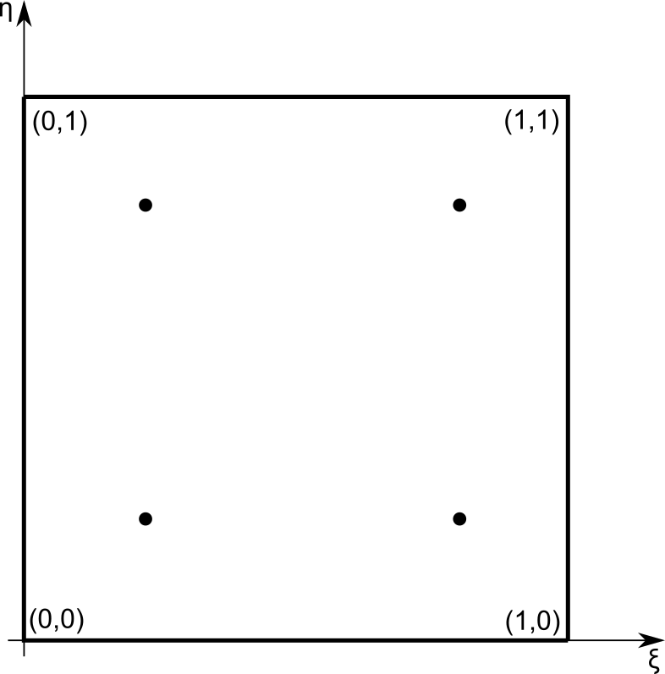
Triangulation (cont‘d)
3. Elements that are not intersected by the trimming curve will be filled according to a quadrilateral rule
Linear Mapping between Gauss domain and Parameter domain
Parameter domain
Gauss domain
Munich, 24. July 2018 | Advanced FEM Presentation | SS2018

Slide 22

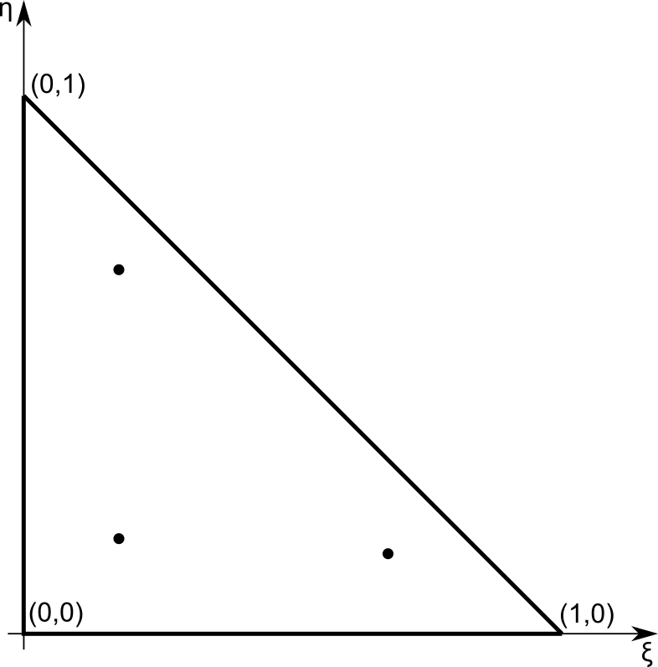
Triangulation (cont‘d)
4. Intersected elements have to be filled with Gauss Points according to a canonical triangle rule
Linear Mapping between Gauss domain and Parameter domain
Parameter domain
Gauss domain
Munich, 24. July 2018 | Advanced FEM Presentation | SS2018

Slide 23
Outline
Introduction
Parsing
Preprocessing
Triangulation
Cables
Fixing Control Points Without Contribution
Gauss Points for Visualization
Results

Slide 24
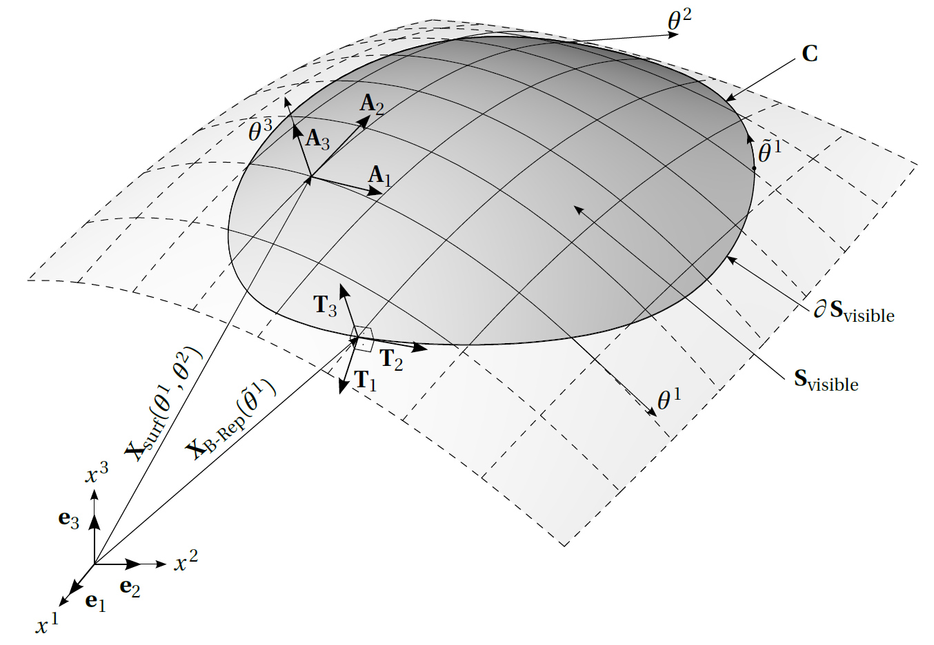
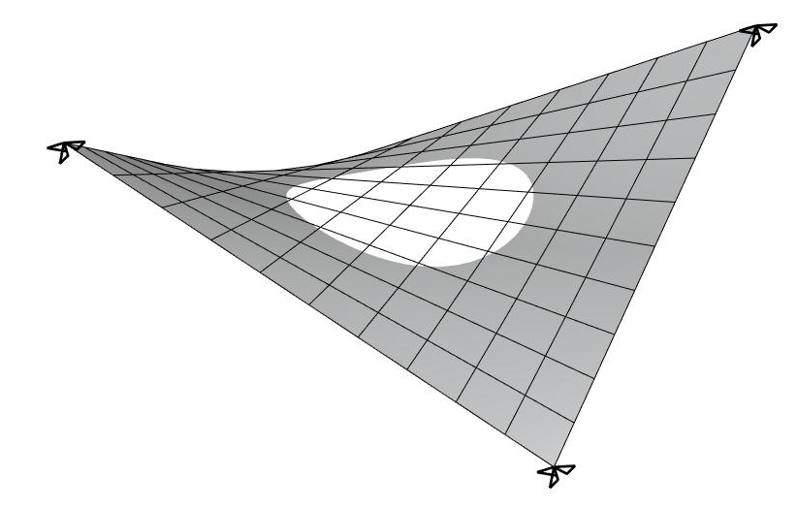

Cables
For membrane theory to be applied, we are adding extra stiffness on the boundaries (cables)
$$A_{1}=\frac{∂X_{surf}}{∂θ^{1}};A_{2}=\frac{∂X_{surf}}{∂θ^{2}}$$
$$T_{trimming}=\frac{∂X_{surf}}{∂\tilde{θ}}=\frac{∂X_{surf}}{∂θ^{1}}\frac{∂θ^{1}}{∂\tilde{θ}}+\frac{∂X_{surf}}{∂θ^{2}}\frac{∂θ^{2}}{∂\tilde{θ}}=A_{1}{\breve{T}}_{1}+A_{2}{\breve{T}}_{2}$$

Slide 25
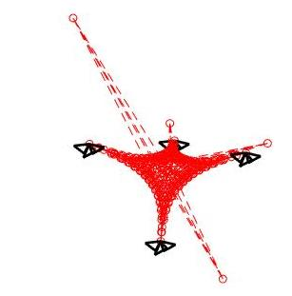
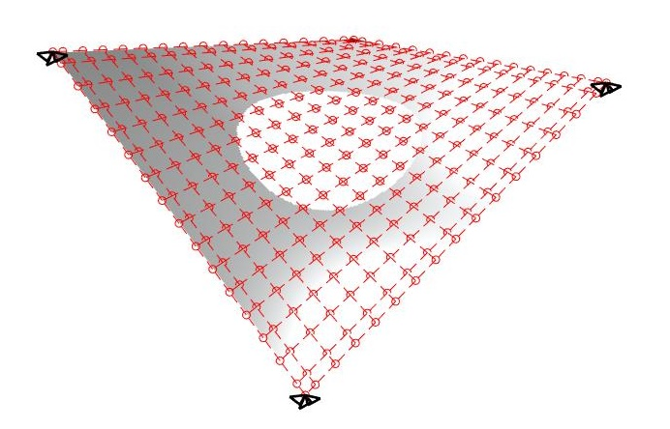
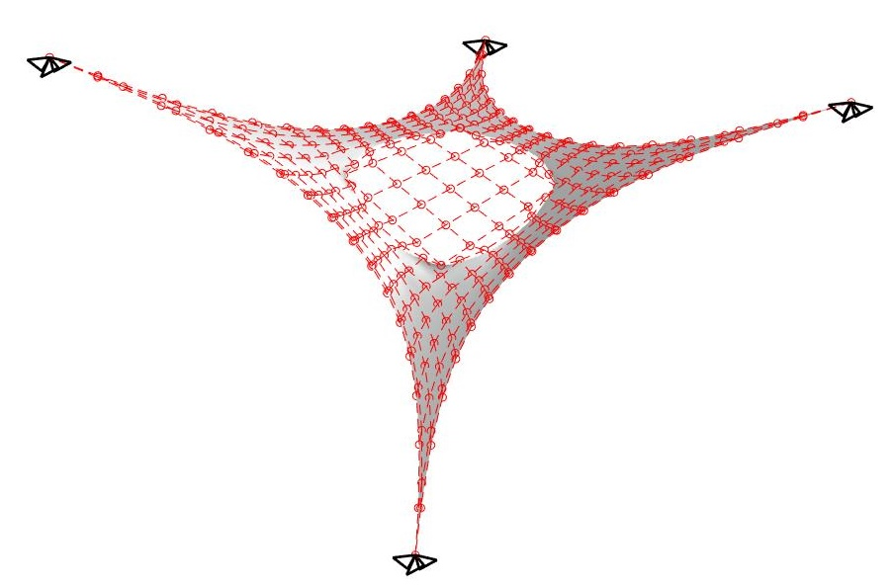
Fixing Control Point without Contribution
Without Fixing
With Fixing

Slide 26
Outline
Introduction
Parsing
Preprocessing
Triangulation
Cables
Fixing Control Points Without Contribution
Gauss Points for Visualization
Results

Slide 27
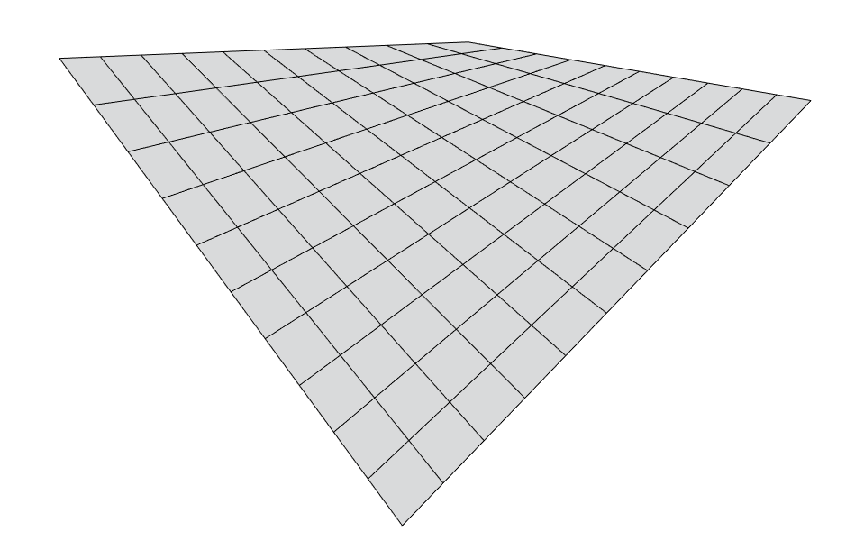
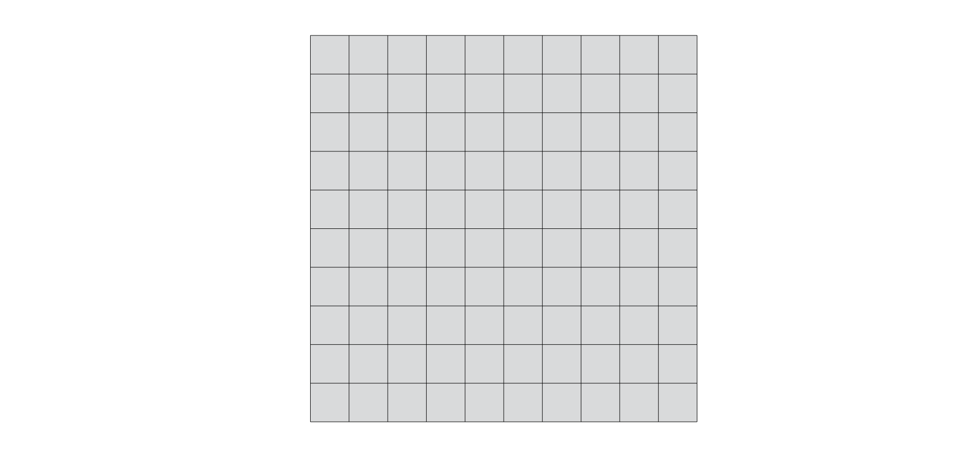
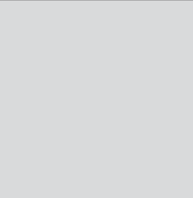
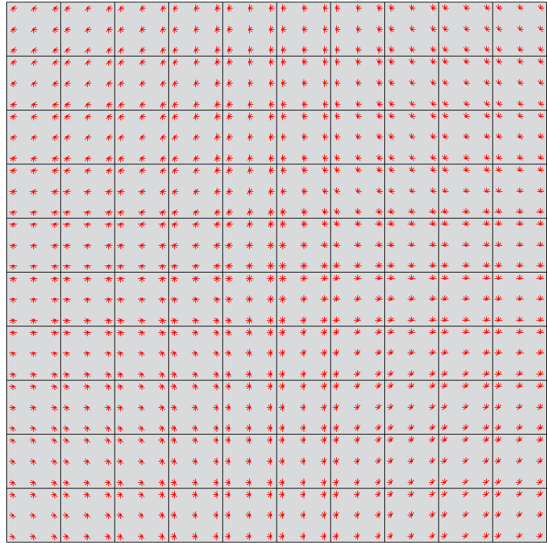
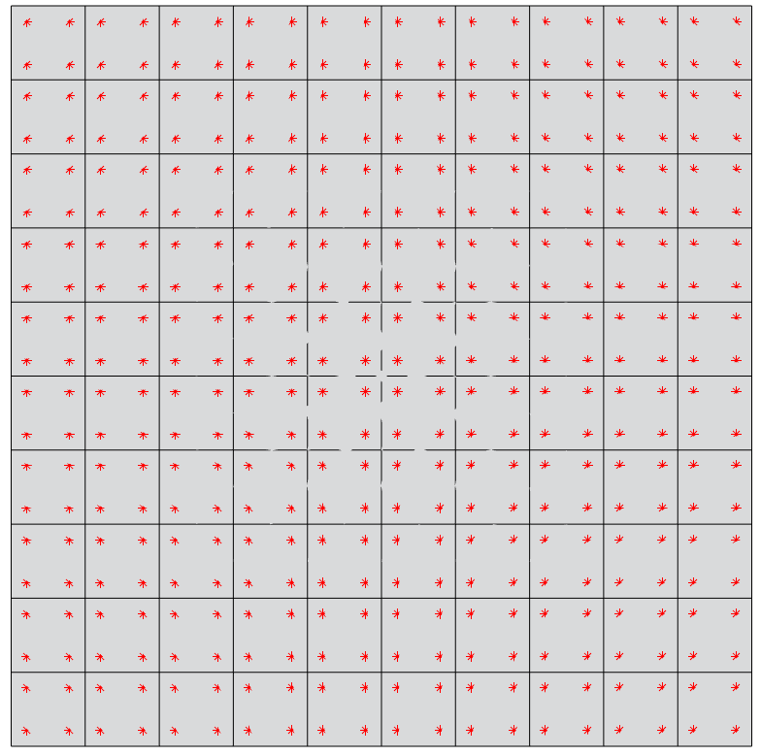
Gauss Points for visualization?
_
η
η
z
y
x
_
ξ
_
_
ξ
Gaussian space (ξ,η) Ε [-1,1]
Physical space (x,y,z)
Parametric space of surface (ξ,η)
Gauss points
Problem : No points on the edges of the structure !!
Solutions :
Add evaluation point to visualize the edges
Use the GPs from the cables running along the edges
3 GPs per direction
2 GPs per direction
Munich, 24. July 2018 | Advanced FEM Presentation | SS2018

Slide 28
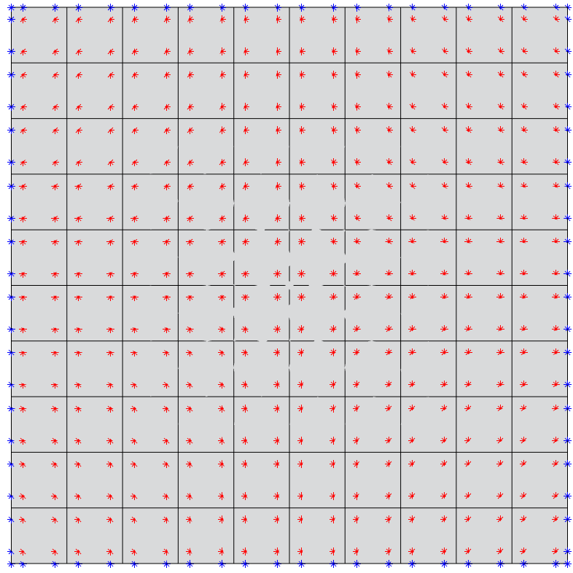
Points at the edges of the structure
* Evaluation points at the boundaries
* Gauss points corresponding to the element
Munich, 24. July 2018 | Advanced FEM Presentation | SS2018

Slide 29
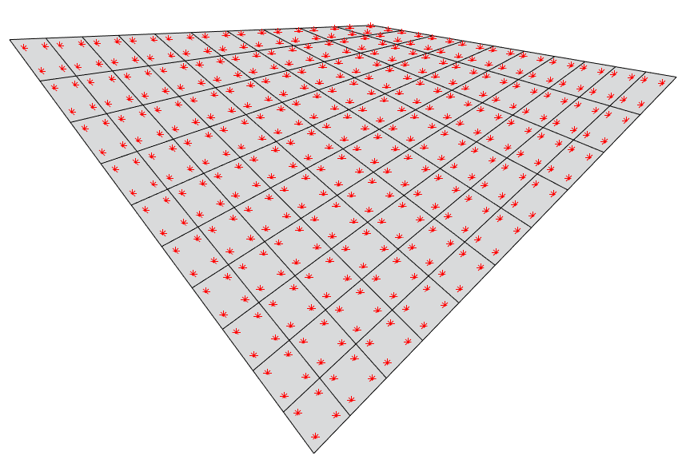
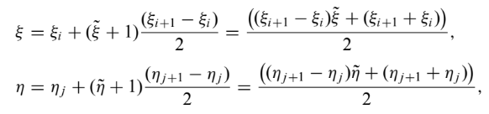
Gauss Points for visualization – How to go about it?
_
_
We have P(ξ_{i}, η_{i})
We get P(x,y,z)
_
Compute basis functions N_{k}(ξ) and N_{l}(η) at (ξ_{i}, η_{i}). Multiply basis functions with CPs of the given element
η
z
Compute corresponding co-ordinates in parametric space of surface (ξ,η)
y
_
ξ
x
Knot spans (ξ_{i+1} ,ξ_{i}) and (η_{i+1} ,η_{i} ) of the element for which the GPs are known
(ξ_{i}, η_{i})
Control points B(x_{i} ,y_{i} ,z_{i})
Source : Cottrell, Hughes, Bazilevs
Munich, 24. July 2018 | Advanced FEM Presentation | SS2018

Slide 30
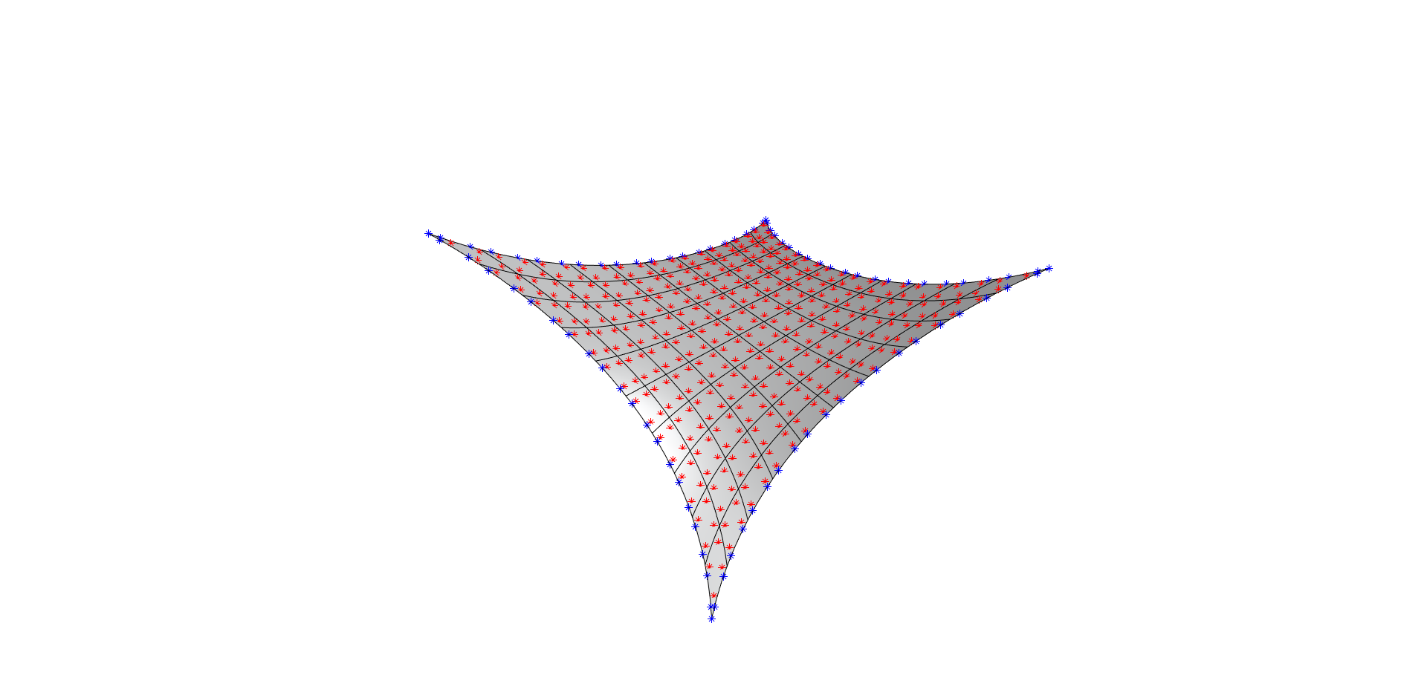
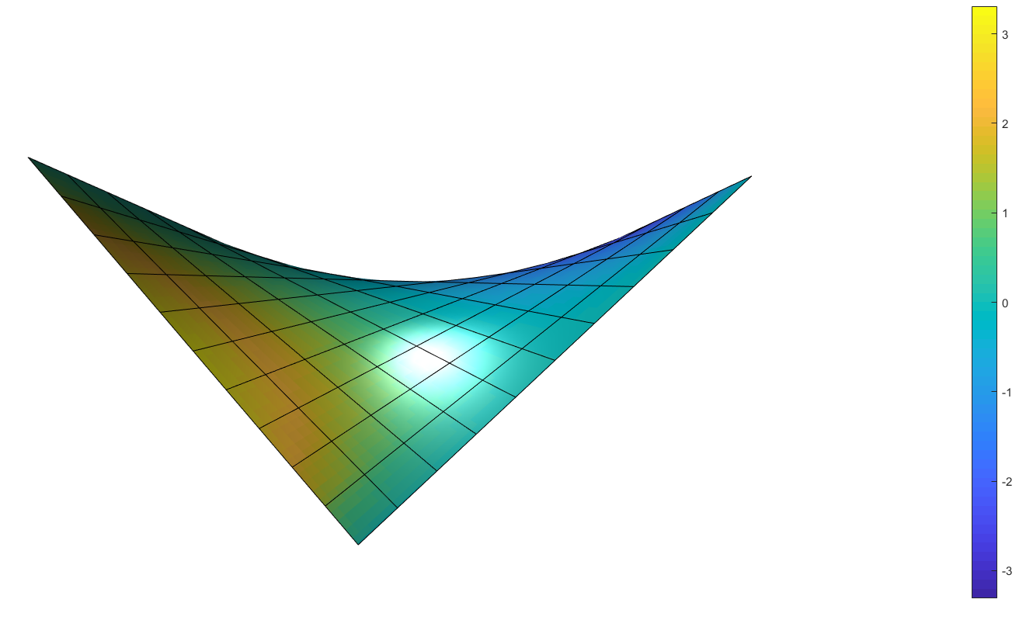
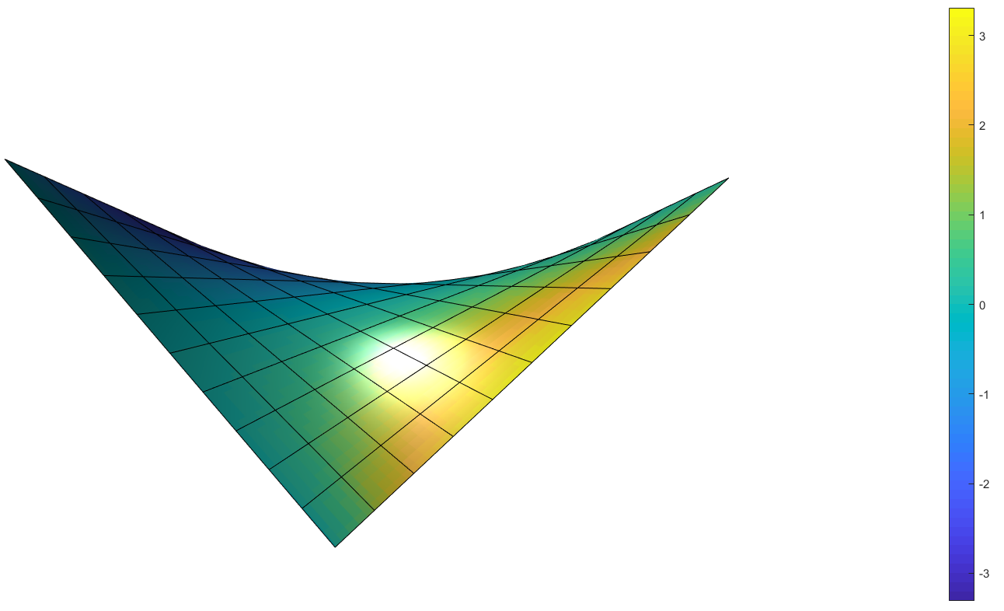
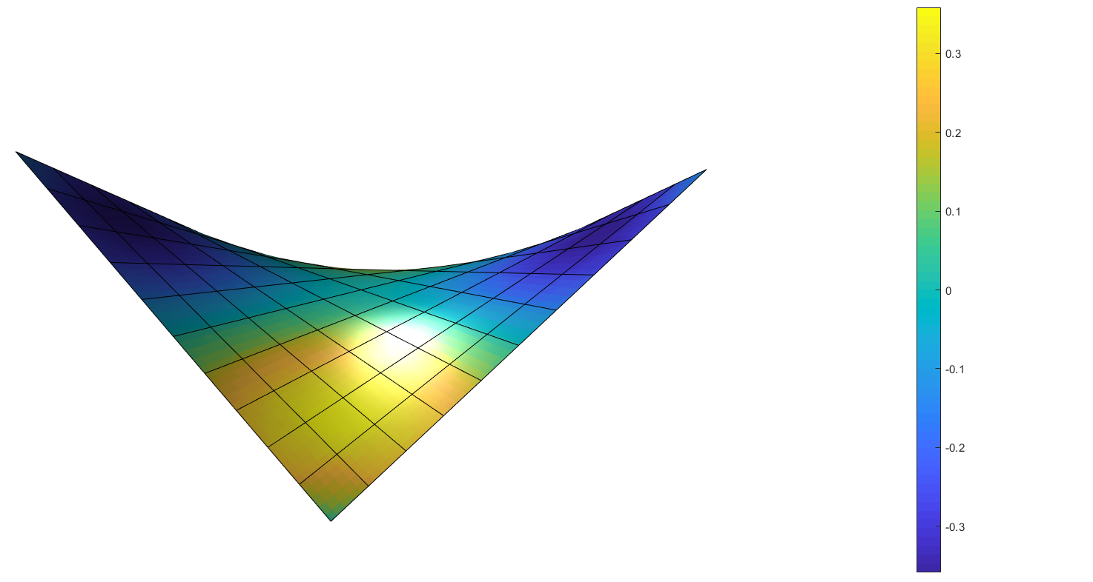
Membrane after form finding
x-displacement
Plotted with respect to initial configuration
Membrane after form finding
y-displacement
Plotted with respect to initial configuration
z-displacement
Plotted with respect to initial configuration
Munich, 24. July 2018 | Advanced FEM Presentation | SS2018

Slide 31
Outline
Introduction
Parsing
Preprocessing
Triangulation
Cables
Fixing Control Points Without Contribution
Gauss Points for Visualization
Results

Slide 32
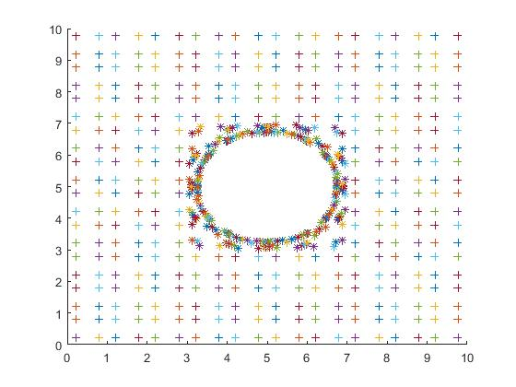
Postprocessing
After trimming the Gauss points are no longer distributed grid wise
Surf command cannot be used
Use plotting command for scattered data or use evaluation points instead of Gauss points

Slide 33
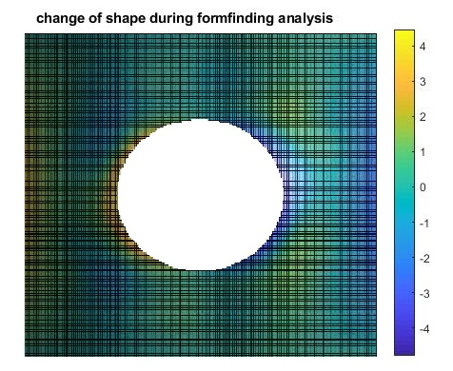
Postprocessing – form-finding
show changes of the shape (e.g. shifting of x-coordinate) during the form-finding process:
sum up displacements of control points in every iteration step, compute corresponding displacements of membrane surface

Slide 34
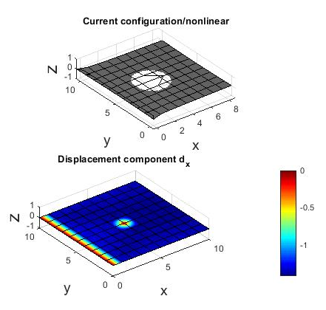
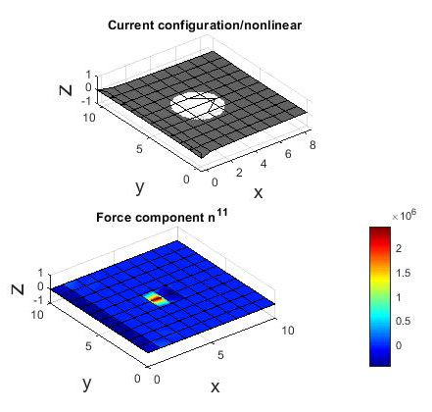
Postprocessing – nonlinear analysis

Slide 35
Next steps
Make the code work correctly / Find the bug
Validate the results using a commercial code (e.g. Ansys)
Write the report

Slide 36
Thank you for your attention
Any Questions?

